Slide 1
Research Methodology- Unit 2 Chapter 3- Research Approach, Conceptual Framework
Prime College- BIM 6th Semester

Slide 2
Research Methodology
Research Approach
Inductive Vs. Deductive
Theoretical Framework
Assoc. Prof Dr Jugindar Singh

Slide 3
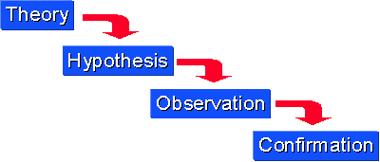
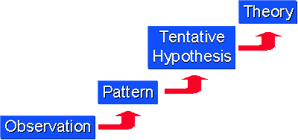
Approaches to Research
Deductive Approach
Top-down approach
A deductive approach is concerned with “developing a hypothesis based on existing theory, and then designing a research strategy to test the hypothesis Wilson, J. (2010)
Inductive Approach
Bottom-up approach
Starts with the observations and theories are proposed towards the end of the research process as a result of observations Goddard, W. & Melville, S. (2004)

Slide 4
Inductive Approach to Research
Induction (Inductive Reasoning)— general principles are inferred from specific observations to arrive at valid conclusions.
Inductive reasoning works the other way, moving from specific observations to broader generalizations and theories.
We sometimes call this a “bottom up” approach
In inductive reasoning, we begin with specific observations and measures, begin to detect patterns and regularities, formulate some tentative hypotheses that we can explore,
Finally end up developing some
general conclusions or theories
Theory
Conclusion
Hypothesis
Pattern
Specific Observation

Slide 5

Example: Inductive
Observation
A low-cost airline flight is delayed
Cats A and B have fleas
Elephants depend on water to exist
Observe a pattern
Another 20 flights from low-cost airlines are delayed
All observed cats have fleas
All observed animals depend on water to exist
Develop a theory
Low-cost airlines always have delays
All cats have fleas
All biological life depends on water to exist

Slide 6
Deductive Approach to Research
Deductive reasoning works from the more general to the more specific.
Sometimes this is informally called a “top-down” approach.
We might begin with thinking up a theory about our topic of interest.
We then narrow that down into more specific hypotheses that we can test.
We narrow down even further when we collect observations to address the hypotheses.
This ultimately leads us to be able to test the hypotheses with specific data – a confirmation (or not) of our original theories.

Slide 7
Example: Deductive
Start with an existing theory
Low cost airlines always have delays
All cats have fleas
All biological life depends on water to exist
Formulate a hypothesis based on existing theory
If passengers fly with a low cost airline, then they will always experience delays
All pet cats in my apartment building have fleas
All land mammals depend on water to exist
Collect data to test the hypothesis
Collect flight data of low-cost airlines
Test all cats in the building for fleas
Study all land mammal species to see if they depend on water
Analyse the results: does the data reject or support the hypothesis?
Only 5 out of 100 flights of low-cost airlines are delayed = reject hypothesis
15 out of 20 cats didn’t have fleas = reject hypothesis
All land mammal species depend on water = support hypothesis

Slide 8


Which way is the bus moving

Slide 9
What are the contents of Lit. Review?
Title:
Relationship among knowledge management, organizational culture and Organization performance of SMEs in Malaysia

Slide 10
Research Framework
Knowledge Management
H1
Organizational
Performance
H2
Organization Culture

Slide 11
End of Chapter 3
Find out more at the PowerPoint Getting Started Center
(Click the arrow when in Slide Show mode)
Notes:
In Slide Show mode, click the arrow to enter the PowerPoint Getting Started Center.

